Slide 1
Computer Architecture Experiment
Topic 6. Dynamically Scheduled Pipelines using Scoreboarding
浙江大学计算机学院
2022年11月

Slide 2
Outline
Experiment Purpose
Experiment Task
Basic Principle
Operating Procedures
Checkpoints

Slide 3
Experiment Purpose
Understand the principle of piplines that support multicycle operations.
Understand the principle of Dynamic Scheduling With a Scoreboard.
Master the design methods of piplines that support multicycle operations.
Master the design methods of Dynamically Scheduled Pipelines using Scoreboarding.
Master verification methods of Dynamically Scheduled Pipelines using Scoreboarding.

Slide 4
Experiment Task
Redesign the pipelines with IF/IS/RO/FU/WB stages and supporting multicycle operations.
Design of a scoreboard and integrate it to CPU.
Verify the Pipelined CPU with program and observe the execution of program.

Slide 6
Scoreboard
Scoreboard Property
In-order issue
Out-of order completion
New Five Stage Pipeline: IF, IS, RO, EX,WB
IS Decode instructions, check for structural hazards
RO Wait until no data hazards, then read operands

Slide 7
Scoreboard Implementation
Instruction Status
No need to record in our lab.
Function Unit Status (FUS)
Register Result Status (RRS)
Which RU will write the register
busy | op | $$F_{i}$$ | $$F_{j}$$ | $$F_{k}$$ | $$R_{j}$$ | $$R_{k}$$ | $$Q_{j}$$ | $$Q_{k}$$
FU_used | Op-type | Rd | Rs1 | Rs2 | Rs1-ready | Rs2-ready | Rs1-waiting-FU-seq | Rs1-waiting-FU-seq

Slide 8
Hazard Detection & Management
Issue
No FU structure hazard
No WAW
Read Operand
Both the operands are available (No issued but non-finished inst. has the same destination. )
Manage RAW dynamically
EX
Once RO finished, EX starts immediately
WB
No WAR
Register Files Structure Hazard is impossible here
Each FU has independent R/W Interface

Slide 9
Your task
Set up independent R/W Interface for each FU
Manage the operation in IS / RO / WB
Detect and manage WAW / RAW / WAR
Manage FUS & RRS
Adjust the VGA so that the FUS/RRS could be seen
Simulation & Implementation

Slide 10
Tips
Different settings for Div Unit

Slide 11
Thinking…
New changes of RVcore32
Why 5 registers are needed after each FU?
Can we WB the result of FU directly into Register Files like lab5?
How does each component of FU entry change in these stages?
Rs1_ready、Rs2_ready
FU_done
Flush & Stall
Explain the meaning of normal_stall & ctrl_stall & jump_stall
The difference of IS_en & RO_en

Slide 12
Bonus
Flaws of Scoreboard
All instructions(for different FU) are waiting in the same queue
WAR and WAW are dealt by stall, which is not efficient
WAR and WAW could be managed by Register Renaming
Bonus1 Scoreboard + Renaming
Bonus2 Tomasulo

Slide 13
Bonus
Request
No code skeletons. Finish the code and test-instructions all by yourself.
Manage WAW & WAR without stall.
The simulation results and implementation results should be included in your report.
Submit your code in course.zju.edu.cn
120% score for bonus, the checking and report requirement are the same.

Slide 14
Instr. Mem.(1)
NO. | Instruction | Addr. | Label | ASM | Comment | Result
0 | 00190093 | 0 | __start: | add x1, x0, x18 | RAW for next round | x1 = 00000001 x1 = 000000c1
1 | 00402103 | 4 |  | lw x2, 4(x0) |  | x2 = 00000008
2 | 00802203 | 8 |  | lw x4, 8(x0) | FU Hazard | x4 = 00000010
3 | 004100b3 | C |  | add x1, x2, x4 | RAW | x1 = 00000018
4 | fff08193 | 10 |  | addi x3, x1, -1 | RAW & FU Hazard | x3 = 00000017
5 | 00c02283 | 14 |  | lw x5, 12(x0) | FU Hazard | x5 = 00000014
6 | 01002303 | 18 |  | lw x6, 16(x0) | FU Hazard | x6 = ffff0000
7 | 01402383 | 1C |  | lw x7, 20(x0) | FU Hazard | x7 = 0fff0000
8 | 40220433 | 20 |  | sub x8,x4,x2 |  | x8 = 00000008
9 | ffd50493 | 24 |  | addi x9,x10,-3 | FU Hazard | x9 = fffffffd
10 | 00520c63 | 28 |  | beq x4,x5,label0
11 | 00420a63 | 2C |  | beq x4,x4,label0 | Jump to 40
12 | 03000a13 | 30 |  | addi x20,x0,48
13 | 03400a13 | 34 |  | addi x20,x0,52
14 | 03800a13 | 38 |  | addi x20,x0,56

Slide 15
Instr. Mem.(2)
NO. | Instruction | Addr. | Label | ASM | Comment | Result
15 | 03c00a13 | 3C |  | addi x20,x0,60
16 | 00004537 | 40 | label0: | lui x10,4 |  | x10 = 00004000
17 | 014005ef | 44 |  | jal x11,20 | jump to 58 | x11 = 00000048
18 | 04800a13 | 48 |  | addi x20,x0,72
19 | 04c00a13 | 4C |  | addi x20,x0,76
20 | 05000a13 | 50 |  | addi x20,x0,80
21 | 05400a13 | 54 |  | addi x20,x0,84
22 | ffff0617 | 58 |  | auipc x12, 0xffff0 |  | x12 = ffff0058
23 | 0223c6b3 | 5c |  | div x13, x7, x2 |  | x13 = 01ffe000
24 | 022687B3 | 60 |  | mul x15, x13, x2 |  | x15 = 0fff0000
25 | 00400113 | 64 |  | addi x2, x0, 4 | WAR | x2 = 00000004
26 | 02808933 | 68 |  | mul x18, x1, x8 | FU Hazard | x18 = 000000c0
27 | 000008e7 | 6C |  | jalr x17,0(x0) | Jump to 0 | x17 = 00000070
28 | 00000013 | 70 |  | addi x0, x0, 0
29 | 00000013 | 74 |  | addi x0, x0, 0
30 | 00000013 | 78 |  | addi x0, x0, 0

Slide 16
Data Mem.
NO. | Data | Addr. | Comment
0 | 000080BF | 0
1 | 00000008 | 4
2 | 00000010 | 8
3 | 00000014 | C
4 | FFFF0000 | 10
5 | 0FFF0000 | 14
6 | FF000F0F | 18
7 | F0F0F0F0 | 1C
8 | 00000000 | 20
9 | 00000000 | 24
10 | 00000000 | 28
11 | 00000000 | 2C
12 | 00000000 | 30
13 | 00000000 | 34
14 | 00000000 | 38
15 | 00000000 | 3C
NO. | Instruction | Addr. | Comment
16 | 00000000 | 40
17 | 00000000 | 44
18 | 00000000 | 48
19 | 00000000 | 4C
20 | A3000000 | 50
21 | 27000000 | 54
22 | 79000000 | 58
23 | 15100000 | 5C
24 | 00000000 | 60
25 | 00000000 | 64
26 | 00000000 | 68
27 | 00000000 | 6C
28 | 00000000 | 70
29 | 00000000 | 74
30 | 00000000 | 78
31 | 00000000 | 7C

Slide 17
Test Bench
RV32core core(
.debug_en(1'b0),
.debug_step(1'b0),
.debug_addr(7'b0),
.debug_data(),
.clk(clk),
.rst(rst),
.interrupter(1'b0)
);
initial begin
clk = 0;
rst = 1;
#2 rst = 0;
end
always #1 clk = ~clk;

Slide 18
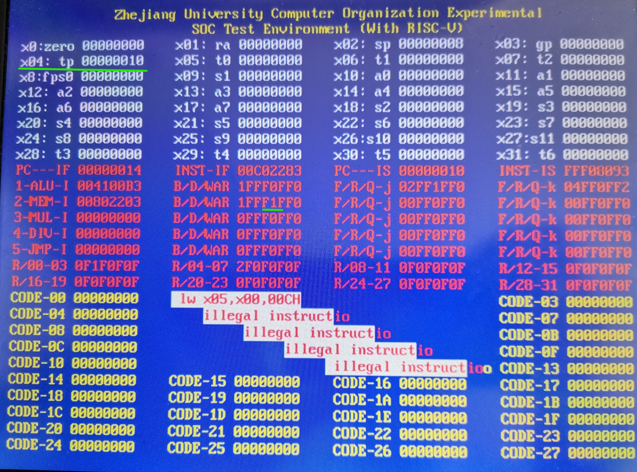
VGA
这里使用 F 作为分隔符

Slide 19
Checkpoints
CP 1:
Waveform Simulation of the Pipelined CPU with the verification program
CP 2:
FPGA Implementation of the Pipelined CPU with the verification program

Slide 20
Thanks!

